Slide 1

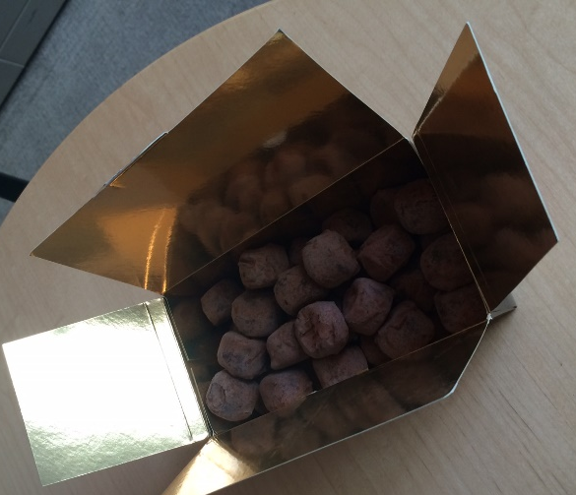
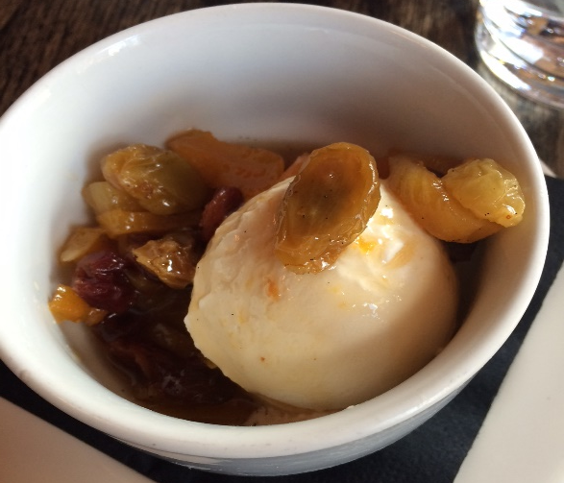
What is Random Variable
Discrete
Finite number of outcomes
The number of chocolates in a box
Continuous
All possible values in some range
The amount of dessert I will eat today
Large number of outcomes -> continuous distribution

Slide 2
What is Random Variable
Are they discrete or continuous?
Today’s weather
Continuous
The color of a car chosen at random
Discrete
Height of a student in class
Continuous
Number of insurance policies issued by a company on a day
Discrete
Sometimes, it is good to approximate discrete as continuous

Slide 3
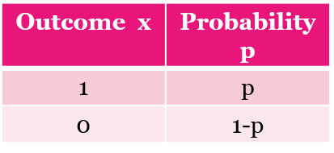
Bernoulli
Let us flip a coin.
X is a RV with Bernoulli distribution
Example: In Delhi, every person has 60% having a vehicle.
1 if they have vehicle, 0 otherwise
X~Bernoulli(.60)

Slide 4
Binomial
Select 10 people in Delhi at random.
Let X = number of them having a vehicle
Of 10 randomly chosen people, what is the probability that first 8 will have vehicle and the next 2 not?
P(YYYYYYYYNN) = (.60)⁸*(.40)²
Imagine 10 Edureka students sitting in front row. If I have to pick three of them, in how many ways can I do it?
How many ways to arrange 10?
10! = 10*9*8*7*6*5*4*3*2*1
Let us say I pick 3 people. In how many ways I can arrange them? 3! For the seven I did not
pick, how many ways? 7!
Therefore, number of ways to pick are

Slide 5
Example
Let us do a coin toss 20 times.
P(H) = P(1-H) = 0.5
X = number of tosses with heads
What is P(X=10)?

